Slide 1
Uva 1513
Movie Collection
Time: 3 seconds

Slide 2
Problem Descriptions (1/2)
Mr. K. I. has a very big movie collection. He has organized his collection in a big stack. Whenever he wants to watch one of the movies, he locates the movie in this stack and removes it carefully, ensuring that the stack doesn’t fall over. After he finishes watching the movie, he places it at the top of the stack. Since the stack of movies is so big, he needs to keep track of the position of each movie.

Slide 3
Problem Descriptions (2/2)
It is sufficient to know for each movie how many movies are placed above it, since, with this information, its position in the stack can be calculated. Each movie is identified by a number printed on the movie box.
Your task is to implement a program which will keep track of the position of each movie. In particular, each time Mr. K. I. removes a movie box from the stack, your program should print the number of movies that were placed above it before it was removed.

Slide 4
Input (1/2)
On the first line a positive integer: the number of test cases, at most 100.
After that per test case:
One line with two integers n and m (1 ≤ n, m ≤ 100000): the number of movies in the stack and the number of locate requests.
One line with m integers a₁, . . . , a_{m} (1 ≤ a_{i} ≤ n) representing the identification numbers of movies that Mr. K. I. wants to watch.

Slide 5
Input (2/2)
For simplicity, assume the initial stack contains the movies with identification numbers 1, 2, . . . , n in increasing order, where the movie box with label 1 is the top-most box.

Slide 6
Output
Per test case:
One line with m integers, where the i-th integer gives the number of movie boxes above the box with label a_{i} , immediately before this box is removed from the stack.
Note that after each locate request a_{i} , the movie box with label a_{i} is placed at the top of the stack.

Slide 7

I/O Example
Input
2
3 3
3 1 1
5 3
4 4 5
number of test cases
Output
2 1 0
3 0 4
Number of
locate requests
number of movies
top
top
3 | 2 | 1
5 | 4 | 3 | 2 | 1
2
3
2 | 1 | 3
5 | 3 | 2 | 1 | 4
1
0
2 | 3 | 1
5 | 3 | 2 | 1 | 4
0
4

Slide 8
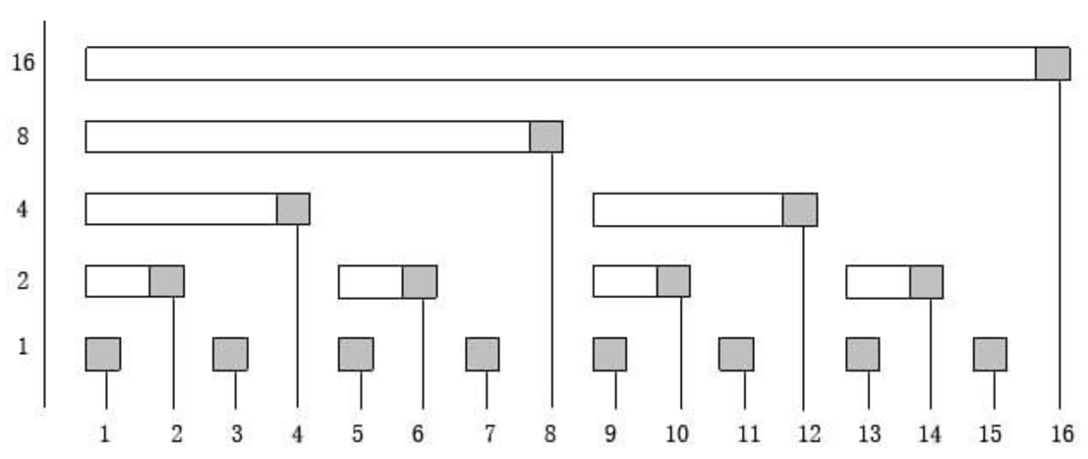
Fenwick Tree (Bit Index Tree, BIT)
Lowbit
Index i

Slide 9
Fenwick Tree (Bit Index Tree, BIT)
Lowbit
9-Lowbit(9)=8
Index i
2+Lowbit(2)=4
7-Lowbit(7)=6
14-Lowbit(14)=12
Parent of index i(right) i-Lowbit(i)
Parent of index i(left ) i+Lowbit(i)

Slide 10
BIT, add( ), sum( ), rsum( )
void add (int x, int d)
{ while (x<=n)
{ c[x]+=d; x+=lowbit(x);}
}
int sum(int x)
{ int ret=0;
while (x>0)
{ ret+=c[x]; x-=lowbit(x);}
}
int rsum(int x, int y)
{ return( sum(y)-sum(x-1) );
}

Slide 11
BIT, add(1, d)
k+=lowbit(k)
Index i
k=0001
k=0100
k=1000
k=10000
k=0010

Slide 12
BIT, add(2, d)
k+=lowbit(k)
Index i
k=0010
k=0100
k=1000
k=10000

Slide 13
BIT, add(3, d)
k+=lowbit(k)
Index i
k=0011
k=1000
k=10000
k=0100

Slide 14
BIT, add(4, d)
k+=lowbit(k)
Index i
k=0100
k=1000
k=10000

Slide 15
BIT, add(5, d)
k+=lowbit(k)
Index i
k=0101
k=1000
k=10000
k=0110

Slide 16
BIT, add(6, d)
k+=lowbit(k)
Index i
k=0110
k=1000
k=10000

Slide 17
BIT, add(7, d)
k+=lowbit(k)
Index i
k=0111
k=10000
k=1000

Slide 18
BIT, sum (7)
k-=lowbit(k)
0100
0110
Index i
0111

Slide 19
BIT, sum (12)
k-=lowbit(k)
1000
Index i
1100

Slide 20
BIT, rsum (7,12)
rsum(7,12) = sum(12)-sum(6)
Index i
rsum(7,12) = sum(12)-sum(6)

Slide 21
Bit Index Tree (BIT)
Given an array with n integers, and n queries and n modifications?
Time Complexity:
Build Bit Index Tree: O(nlogn)
O(logn) for each query.
Therefore, O(nlogn) for n queries.
O(logn) for each modification.
Therefore, O(nlogn) for n modifications.
Overall: O(nlogn)

Slide 22
Solution
1 | 2 | 3 | 4 | 5 | 6 | 7
7 | 6 | 5 | 4 | 3 | 2 | 1
pos
8 | 5
7 | 1
6 | 2
5 | 3
4 | 4
3 | 5
2 | 6
1 | 7
top
7 | 1
6 | 2
5 | 3
4 | 4
3 | 5
2 | 6
1 | 7
pos
7 6
5 2 1 5 6 3
1 | 2 | 3 | 4 | 5 | 6 | 7 | 8 | 9 | 10 | 11 | 12 | 13 | 14
1 | 2 | 1 | 4 | 1 | 2 | 1 | 7 | 0 | 0 | 0 | 0 | 0 | 0
7 | 6 | 5 | 4 | 3 | 2 | 1
1 | 1 | 1 | 1 | 1 | 1 | 1
4

Slide 23
Solution
1 | 2 | 3 | 4 | 5 | 6 | 7
7 | 6 | 5 | 4 | 3 | 2 | 1
pos
8 | 5
7 | 1
6 | 2
5 | 3
4 | 4
3 | 5
2 | 6
1 | 7
bit
top
7 | 1
6 | 2
5 | 3
4 | 4
3 | 5
2 | 6
1 | 7
1 | 2 | 3 | 4 | 5 | 6 | 7 | 8 | 9 | 10 | 11 | 12 | 13 | 14
1 | 2 | 1 | 4 | 1 | 2 | 1 | 7 | 0 | 0 | 0 | 0 | 0 | 0
7-bit(3)=7-(bit(3)+bit(2))=7-(1+2)=4
add(3,-1)
bit
1 | 2 | 3 | 4 | 5 | 6 | 7 | 8 | 9 | 10 | 11 | 12 | 13 | 14
1 | 2 | 0 | 3 | 1 | 2 | 1 | 6 | 0 | 0 | 0 | 0 | 0 | 0
pos
7 6
5 2 1 5 6 3
1 | 2 | 3 | 4 | 5 | 6 | 7
7 | 6 | 5 | 4 | 8 | 2 | 1
pos
bit
add(8,1)
4
1 | 2 | 3 | 4 | 5 | 6 | 7 | 8 | 9 | 10 | 11 | 12 | 13 | 14
1 | 2 | 0 | 3 | 1 | 2 | 1 | 7 | 0 | 0 | 0 | 0 | 0 | 0

Slide 24
Solution
1 | 2 | 3 | 4 | 5 | 6 | 7
7 | 6 | 5 | 4 | 8 | 2 | 1
pos
top
9 | 2
8 | 5
7 | 1
6 | 2
5 | 3
4 | 4
3 | 5
2 | 6
1 | 7
8 | 5
7 | 1
6 | 2
5 | 3
4 | 4
3 | 5
2 | 6
1 | 7
bit
1 | 2 | 3 | 4 | 5 | 6 | 7 | 8 | 9 | 10 | 11 | 12 | 13 | 14
1 | 2 | 0 | 3 | 1 | 2 | 1 | 7 | 0 | 0 | 0 | 0 | 0 | 0
7-bit(6)=7-(bit(6)+bit(4))=7-(2+3)=2
bit
add(6,-1)
1 | 2 | 3 | 4 | 5 | 6 | 7 | 8 | 9 | 10 | 11 | 12 | 13 | 14
1 | 2 | 0 | 3 | 1 | 1 | 1 | 6 | 0 | 0 | 0 | 0 | 0 | 0
pos
7 6
5 2 1 5 6 3
1 | 2 | 3 | 4 | 5 | 6 | 7
7 | 9 | 5 | 4 | 8 | 2 | 1
pos
add(9,1)
4 5
1 | 2 | 3 | 4 | 5 | 6 | 7 | 8 | 9 | 10 | 11 | 12 | 13 | 14
1 | 2 | 0 | 3 | 1 | 1 | 1 | 6 | 1 | 1 | 0 | 1 | 0 | 0

Slide 25
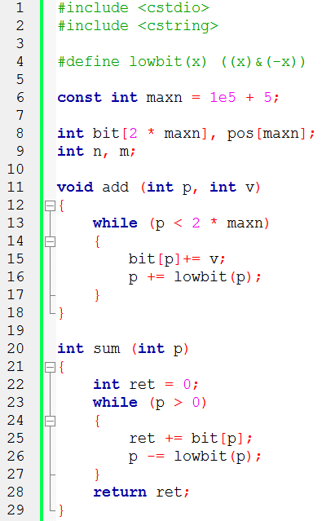
Sample code

Slide 26
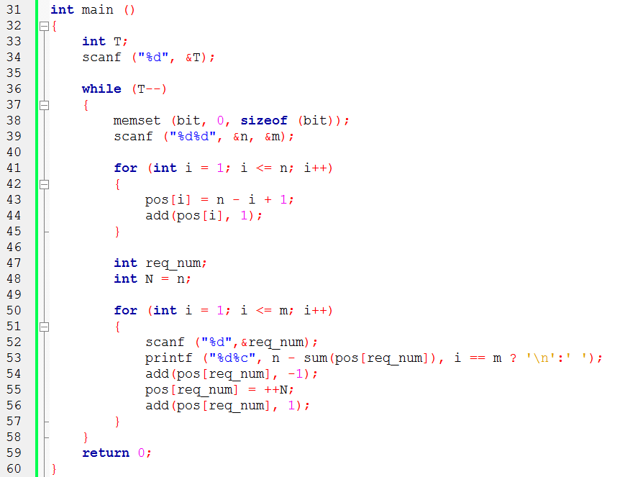
Sample code
build bit index tree
handle request

